Slide 1
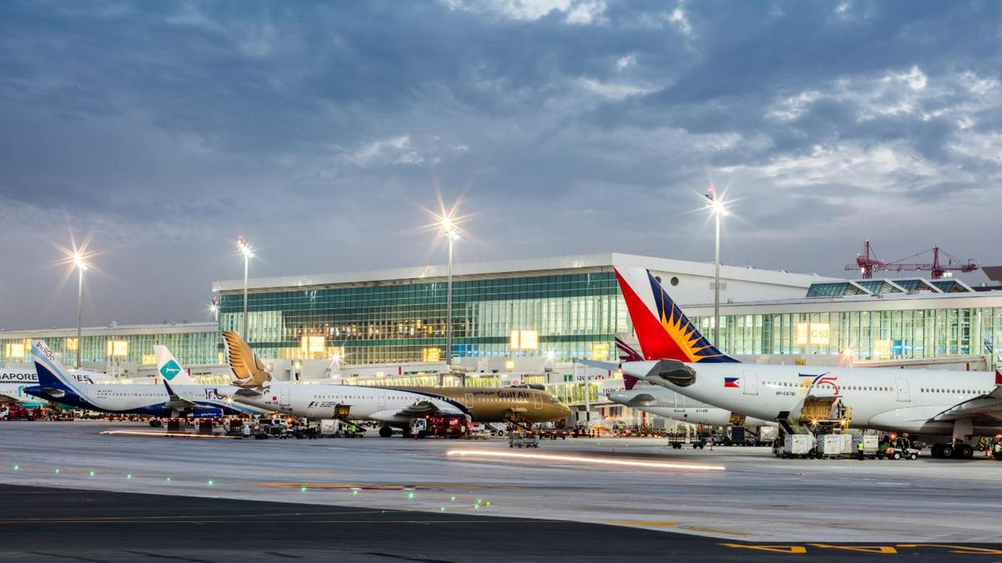
Predicting Upcoming Flight Delays
Shalini Jain
DATA 606 - Delivery 2
Notes:
Hey guys i’m shalini, this is my DATA 606 delivery 2 presentation. Just as a reminder, I am working on predicting upcoming flight delays.

Slide 2
Project Recap
●To predict upcoming flight delays based on previous delays
●Help to prevent future delays
●Help consumers know which airlines/airports to use and/or avoid

Slide 3

Delivery 2 Topics
Project updates
Literature and Industry Research
Comparisons
Data Cleansing/EDA/Visualizations
Next Steps

Slide 4

Project Updates
Focus on weather induced delays
Multiple algorithms instead of just one
Notes:
After receiving feedback from my first delivery, I decided to make a few changes in order to improve my project overall. I have decided to only focus on weather induced delays from my dataset. I will focus on multiple ML algorithms instead of just one. My goal of doing so is to compare the accuracy of each algorithm to see which one works best for my dataset(s).

Slide 5
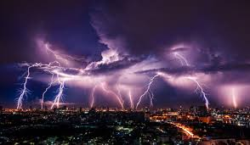
Why I Chose Weather Induced Delays
18.56% of flight delays were weather induced
Interesting to find datasets related to weather
Historical and forecasted weather
Notes:
I decided to do weather induced delays because it seemed appealing and about 18.56% of the delays in the dataset were due to weather related issues. As a result, I am working on finding weather related dataset that will match my 2015 flights dataset. DARKSKY PAI

Slide 6

Literature and industry research/Outcomes
Binary-classifier vs Multi-classifier
Various types of delays
Focus on only one Airline - AA
Validation Accuracy was 85.73%
Notes:
Many projects started off by constructing a model with a binary classifier which means that they were predicting that either the flight was delayed or not delayed. However, I want to use a multi-class model that will predict the magnitude of the delay. Therefore, I will be skipping the binary classifier model.
FOcus on only one Airline & Focus on only 5 airports
Gradient Boosting Classifier Model on flight data (decision trees). From their ML algorithms it seems that by the best of our knowledge, has been the best ever numeric accuracy clocked by any Flight Delay Prediction Model on this dataset.

Slide 7

Comparisons
Multi-class model
Only Weather induced delays
Focus is on 14 airlines
Notes:
As mentioned before, I am only focusing on weather induced delays. Other projects focus on various types of delays such as, aircraft delays, security delays, etc. Additionally, other projects only focus on American Airlines, while my project will analyze fourteen airlines. It also only focuses on five airports, while mine will focus on 322 airports. I also plan to measure the Magnitude of the delay,not just whether or not there was a delay.

Slide 8
EDA / Visualizations
Dropped rows which stated that flights were cancelled
Dropped 89,884 rows
Dropped Reason of cancellation
Dropped columns with type of flight delays (except for weather_delays)
Notes:
Already in pretty good shape before i started.

Slide 9
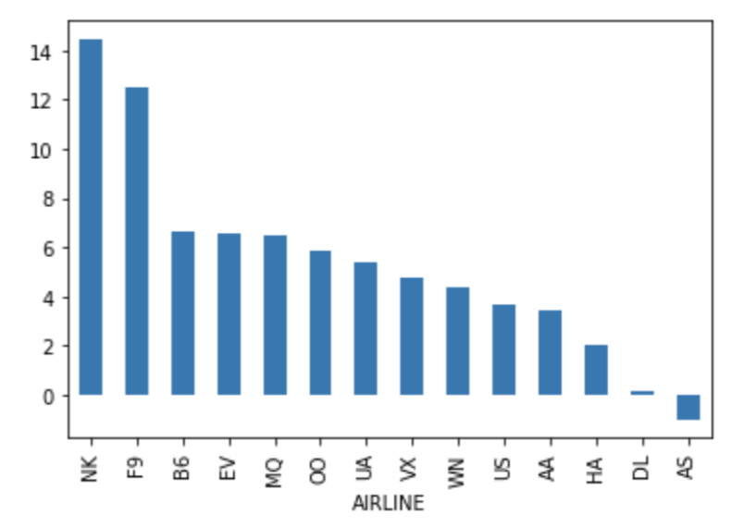
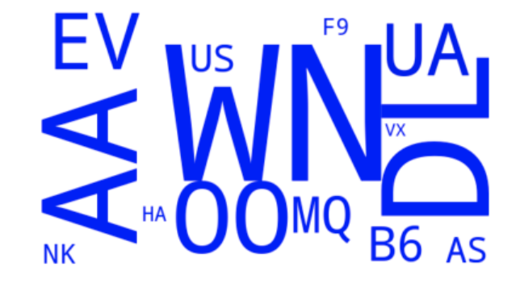
EDA / Visualizations
Notes:
Airlines:
EV - Atlantic Southeast Airlines
WN - SouthWest
DL - Delta Airlines
OO - Skywest
B6 - Jetblue
Nk - Spirit
#average arrival_delays by airline

Slide 10

Next Steps
Finding the right weather dataset that will match my flights dataset
Work on more visualizations with both datasets
Delivery 3:
Finalize data exploration stage
Construct model
Notes:
During my next steps I plan to find weather data that will match my dataset. I am considering DarkSky API. I also plan to work on more visualizations that will include the weather dataset as well. Lastly, I will be working on Delivery 3 which will include finalizing the data exploration stage and constructing my models.

Slide 11

Questions?
Please contact me via email: sjain3@umbc.edu

Slide 12
Resources
https://www.kaggle.com/usdot/flight-delays#airlines.csv
https://arxiv.org/pdf/1903.06740.pdf
https://engineering.upside.com/applying-predictive-analytics-to-flight-delays-85413ca4939f

